Slide 1
Sanitary Sewer Risk Model
Roy Brander, City of Calgary (retired)
Gloria Boorboor, City of Calgary
October 6, 2016
Notes:
Good afternoon, I’m Gloria Boorboor, and I spent 2015 on a project as an EIT in Water Resources. They had been developing a Sanitary Sewer Risk Model for some time. A workshop with Hunter Water Australia nearly 10 years earlier, had developed a set of TBL values for failures. They had picked upper and lower bounds for the money we’d notional money we would have spent if we could, to avoid each of various environmental and social harms, such as to spill wastewater into watercourses, cause subsidence in major roads, or trains, or just backflow into customer basements. If a main is at 1% risk of spilling wastewater into the river and you put a $100,000 TBL notional value on that, you’re really just saying you’d spend $1000 to eliminate even the 1% risk.
I was assigned a project to use the GIS to apply the most major of these TBL consequence valuations across the system, so that we could find all the most critical sanitary mains.

Slide 2
Agenda
Rationale What is this all for?
Methodology How do we do it?
Criteria What information was used?
GIS Analysis High-Tech made it cheap
TBL Calculations Policy enshrined in math
Probability of Structural Failure
Probability of Operational Failure
Results and Conclusions
The other half of risk calculation
Notes:
The presentation will first go over the why of the project. Then we’ll do the how, which breaks down into what information we had to work with, and how we used it – pushing all the available data into a GIS database. Lastly, we will show how those policy decisions of 2006, about the TBL values of failures, were applied to the real world.
But then we’ll go for extra credit – my assignment was just to come up with those criticalities, and this presentation should just be of a criticality model. But by Christmas of 2015, we’d sketched in the other half of a full risk model – come up with a way to offer a probability of failure for every main. We’ll show off that first iteration of a full risk model for dessert.

Slide 3
Rationale: The Benefits
Consequence Side Identifies “Critical Assets”
Reduce risk of spills to water bodies
Mitigate risk of transportation disruptions
Avoid Service disruptions, and property damage
Full Risk Cost Identifies and Justifies Budget
Optimize Capital Spending to only where it pays back
Prioritize replacement, rehabilitation, and inspection
Notes:
About 2009, the Directors started pressing Asset Management for the list of “Critical Assets”. To an infrastructure engineer, every asset has some criticality or it would have no value at all – the little main serving your house is quite critical to YOU.
What they meant, of course, is “assets with such high criticality, we can’t sleep well if they aren’t checked”.
These are the assets that should be inspected frequently and have immediate preventive measures applied if failure seems possible.
Knowing that we’re all over them lets Directors sleep soundly.
But a full risk model, giving dollars of risk per year for each asset – that’s the Holy Grail, because it not only lets you optimize the budget they give you, it provides justification for the budget you need.

Slide 4
Consequence TBL Cost Value
Financial Impact - “Actual” Cost
Increased operating costs due to operational failures
Dig costs due to structural failures
“Notional” Costs we would have spent
2. Environmental Impact
Polluting rivers/ponds/wetlands
3. Social Impact
Disturbance to customers due to main backups
Traffic interruptions
Notes:
These intangible concerns are given monetary value by the TBL system. The project is basically about filling in the 2nd and 3rd bottom lines, the imaginary money value of environmental impacts to rivers, and the social costs to the population from disruptions. As we’ll see later, the real-money dig costs, the 1st of the three bottom lines, dominate the system-wide grand total of consequences, but the environmental and social TBL lines are very large on a tiny minority of mains – those critical assets the Directors needed us to find.

Slide 5
Methodology
Identify criteria available in-house
Perform GIS analysis to identify mains under “location impacts” criteria
Consolidate GIS results into the Asset Management database
Determine TBL values for each criterion, as well as a method for addition of costs
EXTRA! Determine probability of failure – risk model!
Notes:
“Data, data, data”, cried Sherlock Holmes, “I cannot make bricks without clay”. Babylon was built from clay, Machu Piccu from stone: you use what you’ve got. We had a lot of clay saved up, and we used it all. We had one of the best GIS databases in the world, every pipe identified and given material, diameter, and year.
We had 30,000 sewer videos and 10 years of work order records, all tied to them.
Our GIS database had the locations of all the water courses, ponds, roads, and rail. We had the traffic levels on all the major roads. And so we pulled all that together and used the GIS to apply it to every one of 75,000 mains.
Then, knowing where problems could occur, we could apply costs to those mains.

Slide 6
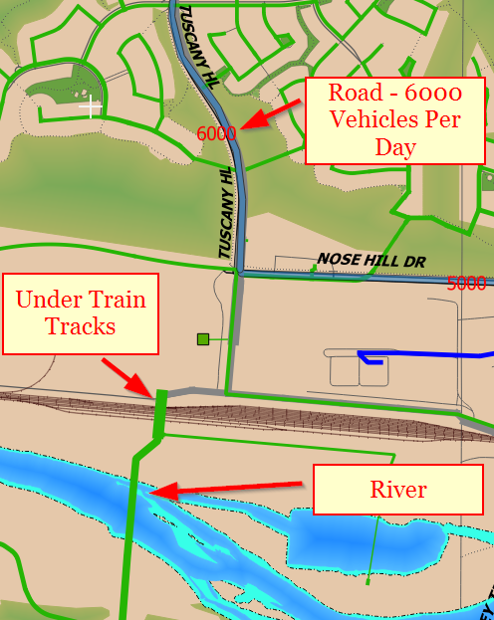
Criteria
Failure Consequences
Position under major roads
Intersection with LRT/CPR
Proximity to major water bodies
Number of services
Notes:
Near the Bearspaw Water Treatment plant, we found a spot where all three major concerns happened in one kilometre of trunk main. The GIS can “see” which metres of the pipe intersect with the river layers at bottom, the train tracks layer in the middle, and the vehicles-per-day stripes overlaid on the major road at top. The river intersection is the most complex, so we’ll use that as the example. Intersections with the linework of roads and tracks were the same but simpler.

Slide 7
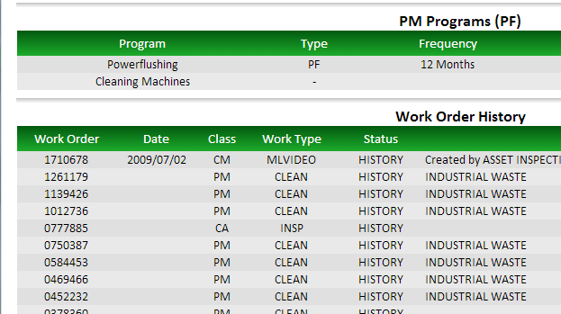
Criteria
2) Probability of Failure
Material
Diameter
Work Orders
CCTV Defects
Notes:
This slide shows the report you can get on any sanitary main by clicking on it in the GIS. We have a web application that consolidates all the data about that main into one report.
At top, the usual data card we have on every main – material, diameter, length, depth, install year, and count of services. Below, a list of every work order against it since 2006. This one shows video and cleaning work orders. Space here doesn’t permit the large video records that would have been at bottom of the web page. We have not just one record for every video, but dozens: every defect seen goes separately into the database.

Slide 8
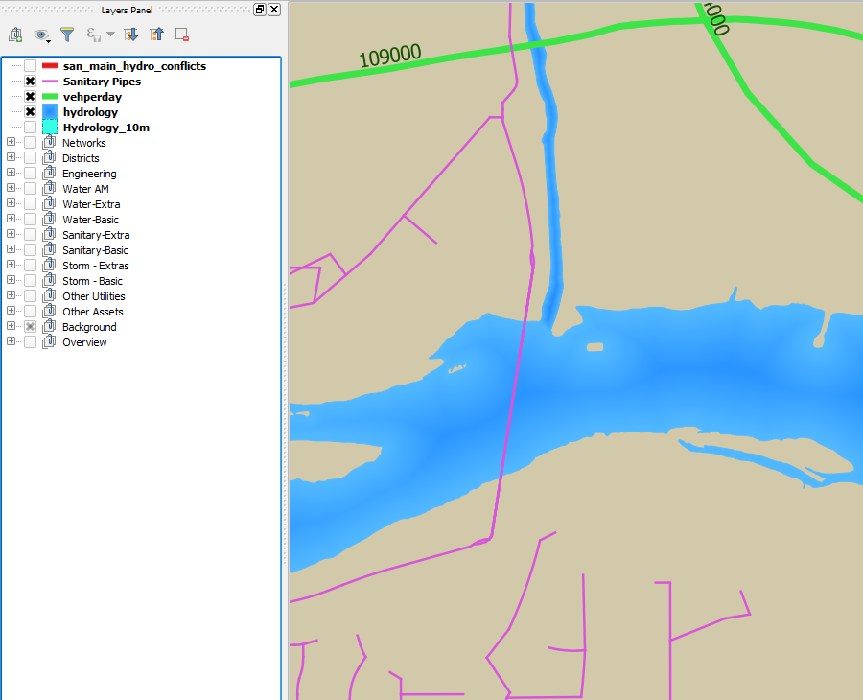
GIS Analysis
Roads and River
Before Buffering
Notes:
Let’s clarify exactly what these GIS operations are. Here’s where Nose Creek feeds into the Bow River, just west of downtown. The river is in blue, of course, the sanitary mains are bright purple, and the green lines are the major roads showing their traffic volume in vehicles per day.

Slide 9
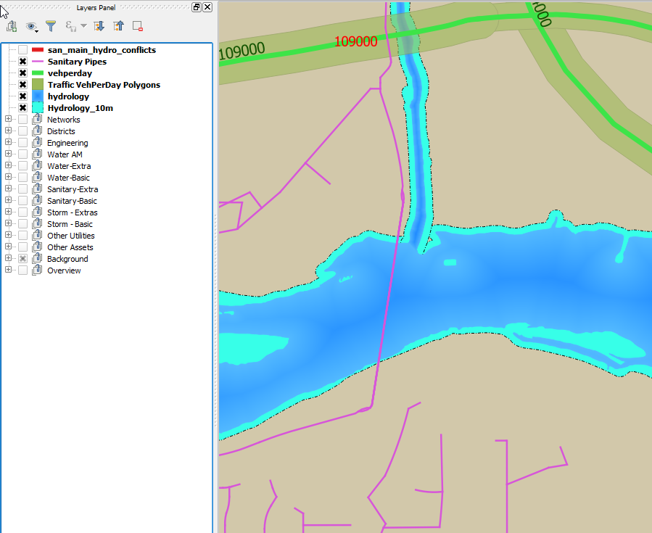
Roads and River
Buffer Layers On
Notes:
This turns on both buffer layers. The river layer is a bunch of polygons that all touch, each one a some hundreds of metres of river. The GIS buffer function creates a new layer in light blue – 10m outwards in all directions from the original river polygons. In pea green, is a new layer created by putting a buffer of 20m around the two-dimensional line of the road layer, creating long, thin polygons.

Slide 10
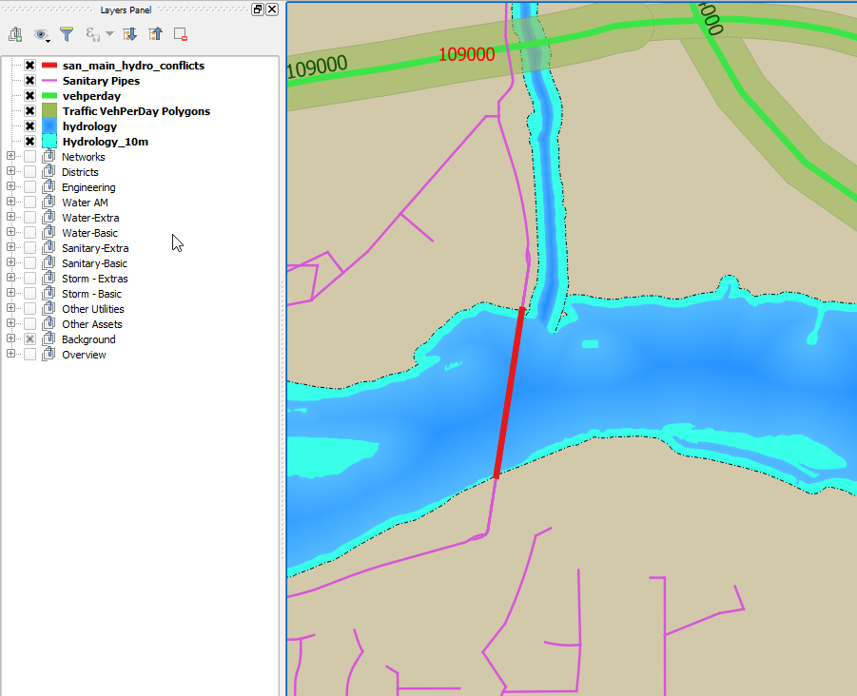
Sanitary Pipe and
River Buffer Layers
Intersection
Notes:
Then in bright red, is a layer created by our other GIS function – intersection. It’s the intersection of the buffered river layer and the purple sanitary pipes layer: just the part of the sewer linework that is inside the river buffer.

Slide 11
GIS Analysis Example – Pipes near Rivers
10m buffered “Hydrology” layer
Pipes within 10m zone
Notes:
The GIS function applies to whole database tables, which in GIS is to say the same thing as map layers. One SQL statement does the whole city. So we found not just the pipes that cross the river in red, but what we were worried that humans would miss. It catches what you see at right…pipes that don’t cross the river, but run for long distances parallel to it.
The concern is that with any leak in the pipe would leak through the river bank into the river, well underground where we wouldn’t see it, as with this one in the Stampede grounds.

Slide 12
GIS Analysis - Results
Pipes within 10m of rivers in TWO lines of SQL
CREATE TABLE hydrology10m as
(SELECT id, ST_BUFFER(geom, 10) geom from HYDROLOGY);
CREATE TABLE SAN_MAIN_HYDRO10_CONFLICT as
(SELECT san_main_id, watershed,
ST_INTERSECTION(san_main.geom, hydrology10m.geom)
FROM san_main, hydrology10m
WHERE ST_INTERSECTS(san_main.geom, hydrology10m.geom));
Notes:
We’re showing you the actual SQL not to teach you geodatabase SQL in a one-minute slide, but only to emphasize that GIS with pure SQL code is not really rocket science. These are almost one-liner statements that an EIT can learn in a few hours of study.
Roy just taught me the two functions – the top one runs the buffer function creating a new layer called “Hydrology-Ten-M” that’s a 10m buffer out from the river.
The second statement does the Intersection. It’s been simplified a bit for space, but the real one is only one line longer. The ST_INTERSECTS function just returns true or false for whether two things intersect; but the ST_INTERSECTION function automatically returns a new linework that’s just the intersecting part of the pipe – the part we’re showing in red.
And that’s how you do GIS magic. We are unclear about why people are able to charge $200 per hour for this.

Slide 13
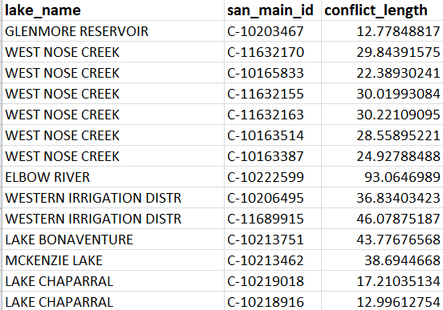
GIS Analysis - Results
Pipes within 10m of rivers: Listed in Table
Notes:
The red lines are the visual GIS expression of the new table as a layer, but it’s also a plain-text database table that gives the name of the water course, from the hydrology layer’s table, the name of the sanitary main from that table, and the length where they conflict – so you can tell if 1 metre or 99 metres of a pipe are near the river.

Slide 14
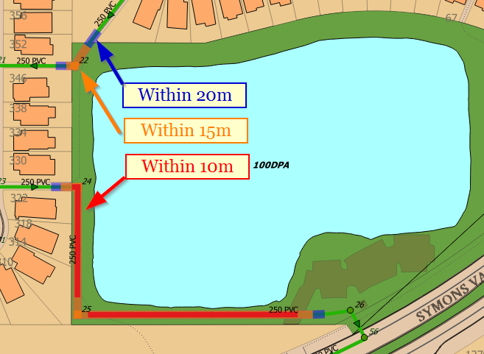
GIS Analysis - Results
Pipes within 10m, 15m, and 20m of ponds/wetlands
Notes:
There are few pipes near rivers, as few as we can manage, but it’s harder to dodge ponds. There are so many of them right next to residential.
And we were worried that we would be overconservative in describing mains as able to foul a pond, when maybe only a few metres of the pipe graze past the buffer around the pond. That exact situation is shown in the upper left of this slide.
So Roy insisted we check – I had to do 10, 15, and 20m buffers around ponds and overlay all three, as you see here – at bottom, most of the pipe is within 10m, but at top, only a few percent of the pipe is within even 15. So for ponds we developed an elaborate system of downgrading the TBL consequences by the fraction of the whole main that was inside the various degrees of buffers.

Slide 15
Consequence TBL Cost Value Calculations – Proximity to Rivers
Based on diameter: Larger diameter, larger TBL value due to higher level of discharge
Discharge into rivers/ponds/wetlands
Min. TBL Cost: $10,000
Max. TBL Cost: $100,000
Comes from 2006 desk study by management, Approved by directors
Notes:
For the environmental bottom line of fouling open water, we used the order of magnitude approved by the Directors in 2006. We would spend $10,000 rather that let a drop of sewage touch the river, and $100,000 rather than have a large trunk dump many cubic metres in.
We used the full $100,000 for trunks of one metre in diameter and above, below that, we pro-rated a bit by diameter.
We pro-rated trunks both by diameter, and the percentage of pipe length inside the buffer. After pro-rating by diameter, if even a metre of pipe was in the buffer, we used half the amount; then from half, up to all of it, pro-rated by the fraction of pipe inside the buffer.

Slide 16
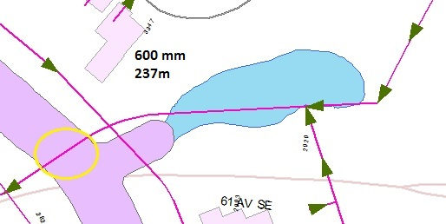
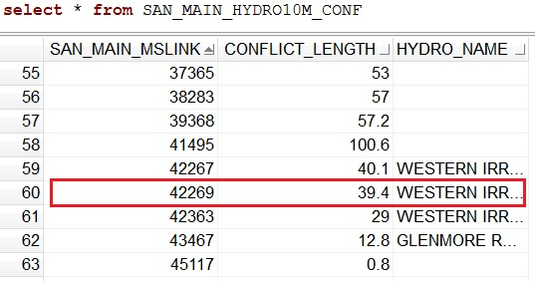
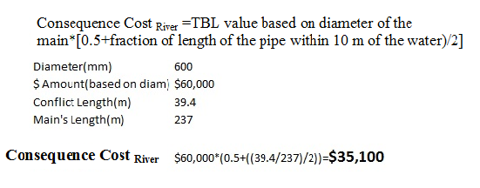
Proximity to Rivers - Continued
16
Notes:
For example this 600mm main is 60% of a metre in diameter so the base consequence was $60,000. But then that is pro-rated again based on the fraction of the main inside the blue pond buffer, because only that fraction of the pipe can have a leak that would go in. We wanted at least half, though, so that pipes with only a metre near the river didn’t have a $25 consequence. Only 39m of 237 in the pipe was near the water, so the final consequence number was just a little over the 50% minimum. Our formula puts a $35,100 consequence on this pipe leaking.
We know this sounds elaborate, but it is the result of a lot of trial and error with formulas that gave to-low or too-high numbers in certain cases.
16

Slide 17
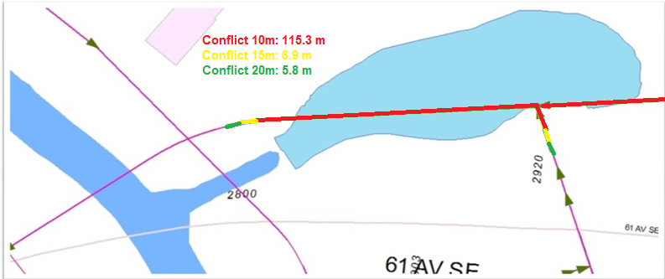
Consequence TBL Cost Value Calculations – Proximity to Ponds/Wetlands
Notes:
As if that wasn’t complicated enough, Roy made me go back and do it again, pro-rating smaller fractions of the total TBL number for sections of pipe within 15 m and 20m.
He was also afraid of under-conservatism, that we’d miss some pipes that had their whole length 11m away from a pond. This analysis was tedious, but it means our answer is bulletproofed against questions about whether we thought of rare scenarios like that. It’s not very expensive to put some higher values on a few pipes, but is hugely embarrassing to miss even one if that’s the one that goes.

Slide 18
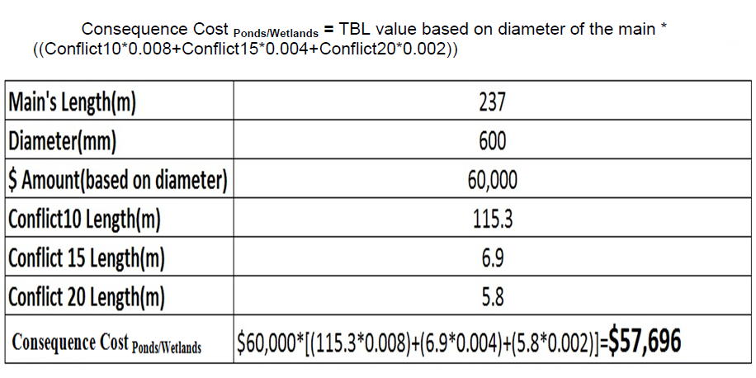
Proximity to Ponds/Wetlands - Continued
Notes:
In this case, where 115 metres of pipe is in the 10-metre buffer and only a few extra metres are within 15 and 20m, Roy’s extra work added only 4% to the TBL value of about 55 thousand if you used only the 10m formula. It wasn’t really worth the trouble on most pipes, but now we KNOW that! We can be sure the figures we do have are neither overestimates or underestimates, that we spotted edge cases. Roy was painfully aware that we were using a computer to do things draftsmen normally did. A draftsman would notice that he was about to ignore a pipe 10.1 metres away from a river; a computer is too stupid. The extra checks were a primitive type of artificial intelligence.

Slide 19
TBL Cost Due to Position under Major Roads (Traffic Impact)
For larger roads (Deerfoot, Crowchild), below cost is divided by 2
Includes cost for traffic control/detour/road closure
Notes:
On to the 3rd bottom line of social costs, mainly, traffic. Calgary Roads puts a value of $5 per car for every vehicle-per-day of traffic volume of a road blocked. We used to use $10 per car, but it was pointed out to us that if we have to set up traffic control at all, it’s a thousand dollars for the first car. So we used this formula that started with $1000 and adds Road’s $5 figure.

Slide 20
TBL Cost Due to Position under Major Roads (Traffic Impact)
Notes:
It took some sweet-talking to get Roads to give us a linework layer that had a “vehicles per day” column for each link of major road. They normally only use it internally, so you have to find the right tech and promise not to share it. We’re showing not their linework layer, but our 20m buffer layer in light green, with the vehicles-per-day number as the label.

Slide 21
TBL Cost due to Position under LRT/CPR
$1,000,000 for a sanitary main intersecting with LRT/CPR, and diameter>525mm
$50,000 for a sanitary main intersecting with LRT/CPR, and diameter =< 525mm
Also based on 2006 study, director-approved policy
Reflects extra construction costs where failure cannot damage the track but repair would need pipe bursting or other trenchless options
Notes:
A wastewater release causing subsidence under a rail line is nearly our worst nightmare.
Right behind being stuck in an elevator with Donald Trump.
So that has a million-dollar consequence attached, which we only apply to trunks. With mains 3m down, we didn’t see smaller sanitary collectors posing that major a danger under rail, where there’s a deep base of gravel. The $50,000 is not about our aversion to halting the Trans-Canada cargo lifeline, that’s very unlikely. It just that we’d be forced to do expensive trenchless repair.

Slide 22
TBL Cost due to Backup into Services
Based on diameter: Larger diameter, larger TBL value due to higher level of backup
Min. TBL Cost: $1,000
Max. TBL Cost: $10,000
Takes into account 2 components:
Impact of backup on “Upstream” residents
Impact of backup on a pipe’s own services
Notes:
Lowest on the disaster totem pole is the poor, long-suffering customer. A backup is tragic for them, but not for a large number of people. Most backflows, mercifully, just cause a basement puddle and those are all the way down at $1000. A larger backflow, where we do have some services going into mains of nearly trunk diameters, is more like $10,000. These calculations required no GIS. We have every service drafted and our drafting system records all pipes as a connected network. We’ve always had the count of the residential and commercial services on every main, and their diameters, giving us an estimate of the number of people behind the service.

Slide 23
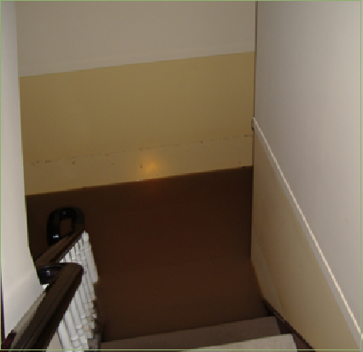
Operational Failure
“IMPACTS”
Where the sewage doesn’t just “Not Leave”
It Invades (Backflow)
Not Recorded Systematically
(Was inferred from comments)
One Choke-Event Can Cause Multiple Impacts to Multiple Customers
Notes:
This is not the TBL value for a simple choke where sewage stops leaving; most of those are restored same day with minor inconvenience. We had to develop a separate database search called IMPACTS, where there is backflow into the premises, as with this house that’s lost two feet of basement.
The TBL value here is huge, of course, ten thousand dollars would actually be low for this very rare case. But perhaps because of our embarrassment, we didn’t have a check-box on the job form for it. Our priceless maintenance planner of the time, Jeff Galloway, sat down and read the comments in 3000 work orders. Then he knew what to put in an SQL statement a page long that looks for any combinations of certain phrases in the comments that indicate sewage inundation. With that amazing job, we had an IMPACTS count for every main.

Slide 24
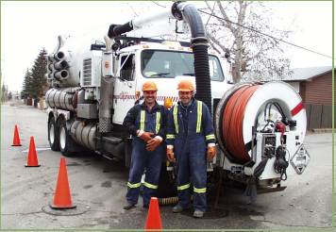
Operational Failure Does Not Require Digging
Flushing
Cleaning Machine
Root Removal
Notes:
You can get backup with either of the two failure modes. Structural failure is where the pipe itself is broken and you have to dig down to repair. Operational failure is where the pipe is fine, but plugged, and you can unplug it with no dig – and thus no dig costs.

Slide 25
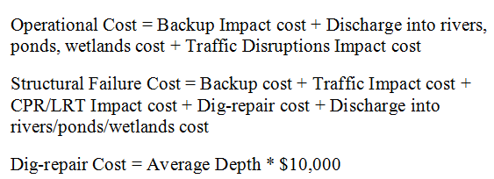
Addition of TBL Consequence Costs
Two failure modes:
Structural Failure
Operational Failure
Notes:
Operational failures are also unlikely to cause subsidence for roads or rail, because sinkholes come from leaks, not plugs. So we have separate TBL scenarios for operational failures and structural failures. The operational cost just leaves out dig and subsidence costs from it’s grand total.
The dig-repair cost is pretty approximate - $10,000 per metre is close from about 3m to 6m, which is 98% of our pipe.
So we ran all these equations and added new columns to our sanitary mains database table: for traffic cost, dig cost, hydrology cost, train costs, service costs. It added seven new columns to the sanitary mains table. The five TBL values, plus the structural and operational totals.
So, I was done. Here’s Roy to show my results and scoop all the credit.

Slide 26
Results – Structural Costs
Notes:
With Gloria’s calculation done, you can add up the TBL costs for all 75,000 mains, and come up with the fanciful figure for the total TBL cost if every sewer main in Calgary failed structurally. The pie chart combines the actual digging and repair cost based on their recorded depths, and the notional TBL costs you’d pay rather than have failures. Most mains are not in such locations, so the basic dig cost is still three-quarters of the four billion dollar total.
Most of the TBL values we do have are from Traffic Costs, which affect about one road in ten in the city. We have far fewer crossings of train tracks, so though they are each very high prices, it’s a small pie slice. And most of all, we hate going under rivers, which is confined to a few dozen large trunks. So HydroCost, the sum of citywide hydrology impacts if every impact hit, is tiny compared to the rest – for which we are duly thankful.

Slide 27
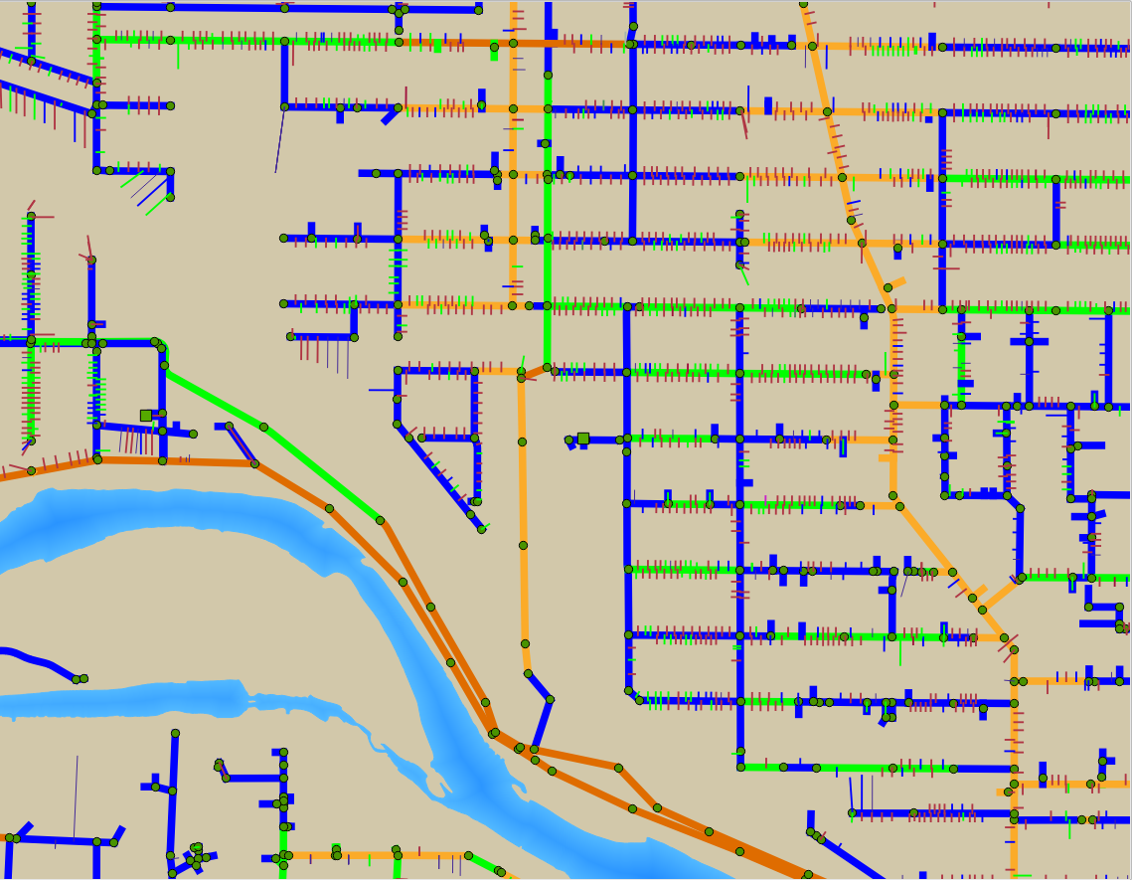
Notes:
While TBL values are a minority, they are decisive where they factor in at all. This map shows those same Structural Failure TBL costs on a main-by-main basis, as a map, with cold blue for under $50,000, just the basic dig cost. Then green, oranges and reds for hotter cases with TBL costs pushing it up to one, two and three hundred thousand. You notice right off the transition from blue to green is mostly just that green mains have more services on them, or larger commercial services – the smallest TBL addition but the most common.

Slide 28
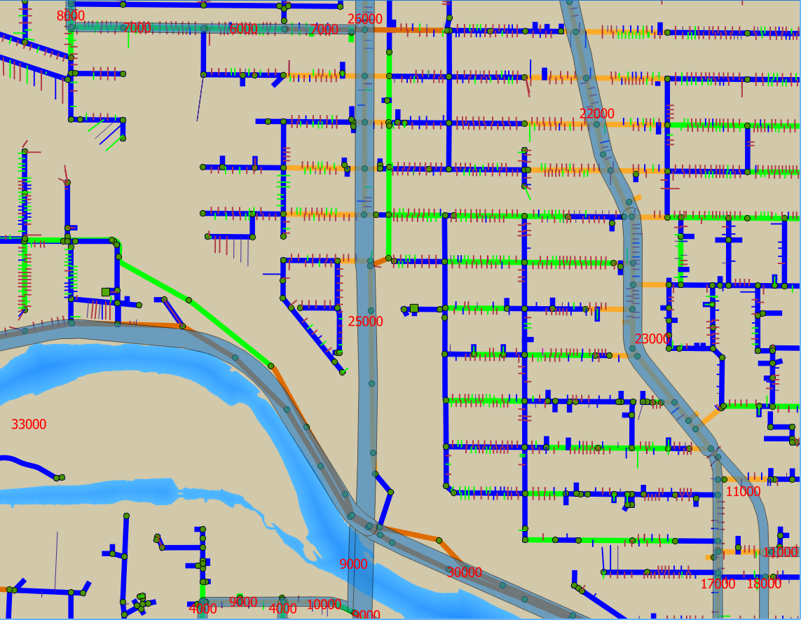
Notes:
Superimposing the high-traffic roads layer in blue, with the vehicles per day number in red, explains most of the orange mains: they’re under high traffic roads. You even see some dark orange for TBL above $200,000 on major thoroughfares, where we’d have to delay tens of thousands of cars per day.

Slide 29
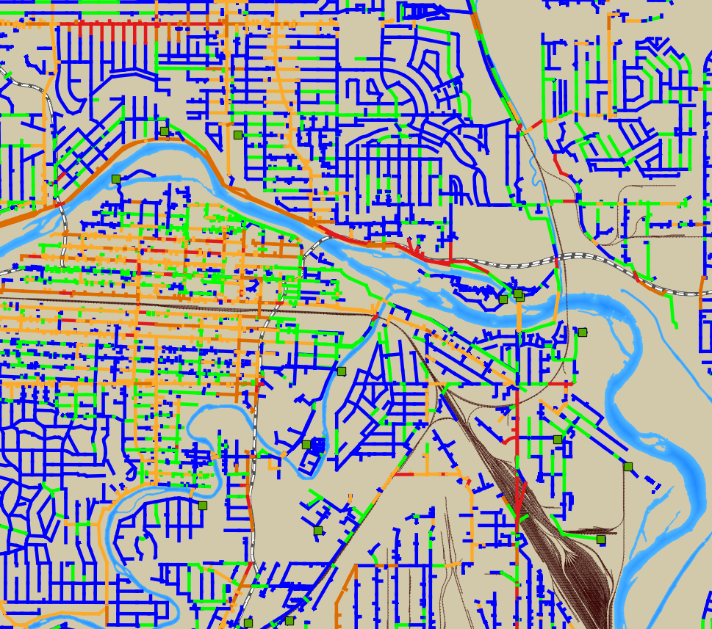
Notes:
Zooming out, you can see the red mains are mostly on downtown streets, go under the LRT tracks or rivers. This is what you show to the Directors, where they just have to know the red ones are the “critical assets”.
The only ones that really require manual concern are those way outside our model. Look just left of the bottom left of the legend. The two giant trunks that go under the Alyth Rail Yards, carrying most of the sewage in the city, are at least red, but that’s only because the computer won’t do flashing ultraviolet lasers in your eye and screaming klaxon horns. My brain adds those every time I look at them. It’s safe to say they’re a high priority for pro-active inspection.

Slide 30
EIT Project Done!
Original Job was just these Consequences
Prioritizes most-critical mains
Must be combined with probability of failure to get RISK.
Roy insists on going for extra credit
Notes:
It is at this point that Gloria’s EIT Project was complete; we had consequence numbers for major and minor failures on the whole system; we could tell the Directors not just that all “critical mains” had been identified, but that we had criticality nailed down numerically for every pipe. But that’s just half of a risk model. To compute risk, you need to know the probability you’ll have to pay that consequence cost. I had recently spent 20 years coming up with a complete risk model for water mains, which Joanna Line and I presented yesterday. I was retiring in just one more month, after several years of building up all the data needed to find a probability model. I was out of time to look. Could we find something in a month? At least a first-draft failure estimate model? We tried, and here’s the result.

Slide 31
Probability of Structural Failure (CCTV not Available)
Dig-Repair Work Orders
compared to Material, and Diameter
Probability Table for Non-Videoed San Mains
Notes:
Similar to developing the consequence-cost model, you work with the data you have. Where we have no video inspection of a main, we rarely have any other work order, either. We really only have material, diameter, and year – and every sewer engineer knows there are 10-year-old pipes with trouble and 100-year-old pipe with none, so “year of install” is surprisingly useless.
Across our large body of data, though, we found real differences in work-order counts for different materials. It’s very distinct for concrete versus vitreous clay tile, and far lower again for PVC. VCT pipes have seventy times as many digs per capita as PVC.
It’s not different for every diameter, but break it into two broad diameter groups – above and below 300mm – there’s a clear correlation. VCT mains over 300mm have half the rate of digs of smaller ones, concrete mains a third. PVC and other materials had no diameter differences, though, so in total, we basically could put 6 different numbers into a probability table for your chance of a dig-repair next year on any given main, from material and diameter alone. It wasn’t very fine-grained, but it was all we had for mains with no inspections.

Slide 32
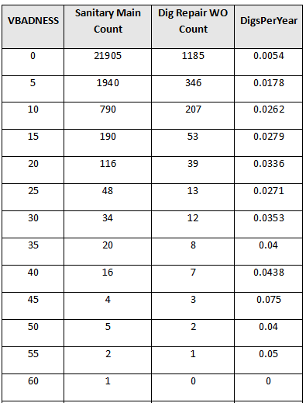
Probability of Structural Failure (CCTV Available)
VBADNESS compared to number of Dig-Repair Work orders
developed as a point-system for summing up structural defects seen in CCTV videos
4 pts per hole
90-180 degrees
6 pts per collapse
3 pts per hole
30-90 degrees
Notes:
Where we have a video, we are rich in data indeed, sort of too rich. We have the location and size of every disjoint, open joint, hole, fracture and deformation in the main. It was an earlier project to find a metric, a way to summarize the whole inspection. The WrC score system only finds the worst metre, it finds repair sites; it doesn’t sum up the whole main.
I use the joke-word BADNESS to name a database column that summed up a point-system for all the bad indicators on a main. The funny name emphasizes that it’s an arbitrary point system. Part of the total BADNESS of a sanitary main is the points for defects seen in sewer videos, which we called VBADNESS. It only counts significant defects, not every crack – so of 30,000 mains videos, only about 5000 mains have any VBADNESS for collapses, bad joints, or holes … as shown in the formula here. Less than a hundred mains have a VBADNESS over 35, as seen in the table at right. We compared VBADNESS to the ten-year count of dig-repair work orders from the work order system.

Slide 33
Probability of Structural Failure (CCTV Available)
Notes:
…and found they correlated fairly well. The VBADNESS number surprised us with a remarkably good correlation to odds of a dig work-order per year. It was close enough to use for prediction! We had a very rough model for mains with no video, and a decent one where there was a video, which was nearly every main that’s ever been a problem.

Slide 34
BADNESS
Arbitrary Point System for EVERYTHING
we know about the main that is “Bad”
BADNESS =
VBADNESS + (video holes, disjoints, etc)
REPLACES X 12 + (partial replacement jobs)
REPAIRS X 8 + (dig-repair jobs)
ROOTS X 4 + (root removal jobs)
Corrective Cleanings X 2 + (cleaning-machine jobs)
Corrective Flushings X 1
Credit: Marina Reeves, EIT, 2011
Notes:
To get the full BADNESS number we add VBADNESS to another point system for past work orders that have equivalent values. I had many years of leveraging EITs the way a professor uses grad students. The endless trial-and-error that found point-scores for work orders of appropriate relative value to each other, AND to the video point system in VBADNESS, was an earlier EIT project. In 2011, it was months of work for then-EIT Marina Reeves, who went on to manage all our EITs. Using Marina’s formula, we compared the total BADNESS number for every main and its count of IMPACTS from 2006 to 2015, the whole ten years we’d had a work-order system.

Slide 35
(Impacts 2006-2015 ) = Impacts/Year 10
Notes:
Ten years of impacts divided by ten gave us average impacts per year, on the Y, with BADNESS on the X.
It speaks for itself, but as a personal note, when this graph first appeared on my computer, I choked up a bit. Eleven days to retirement, it was the last day of work before Christmas, and I was still doing research. That found useful things. The correlation coefficient was a stunning 0.95. More than good enough to use for infrastructure planning and budgeting. We had a full risk model for both failure modes.

Slide 36
Risk Calculations
Load in 8 probabilities for “DigsPerYear” where no video
update san_main set digsperyear= 0.0011 where VBADNESS =0 and diam>299 and mat='CON';
update san_main set digsperyear= 0.0002 where VBADNESS =0 and diam<300 and mat='PVC';
update san_main set digsperyear= 0.0002 where VBADNESS =0 and diam>299 and mat='PVC';
update san_main set digsperyear= 0.0001 where VBADNESS =0 and diam<300 and mat='CON';
etc…
Do Correlation Equation with VBADNESS where there is video
update san_main set digsperyear = 0.0008 * VBADNESS + 0.0133
where VBADNESS>0;
Risk is Probability Times Consequence: Show Me The Money
update san_main set StructRisk = DigsPerYear * StructCost;
Notes:
Then I retired. And Gloria went on to her next EIT rotation and was forced by slave-driving traffic engineers into doing their signs and signals stuff. She did this presentation in the evenings. Our replacements had a lot of catch-up to do, and other priorities; the full risk model has not yet been implemented. Even though both halves were ready to multiply together.
And I just had to see the finish line. What the heck, I’d kept a copy of the data tables on my laptop. So last week, I processed all these SQL statements with the 6 probability numbers, and the VBADNESS formula from the graph. This created a “DigsPerYear” column for the assumed structural failure count per year. Then I multiplied that by the total StructCost column from Gloria’s project. And I got 8 million dollars a year of risk.

Slide 37
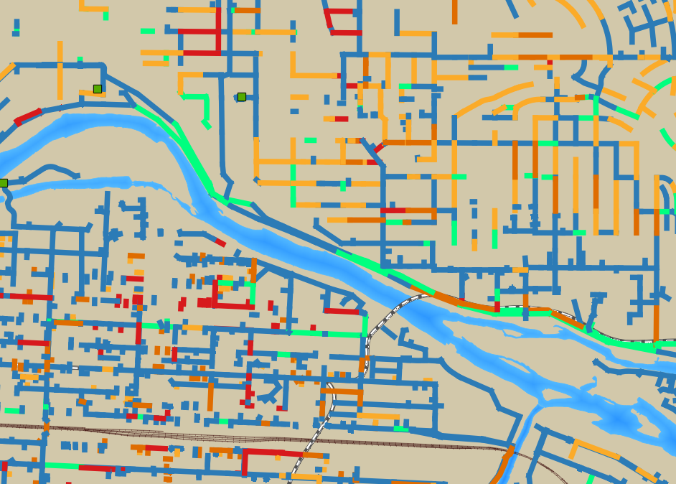
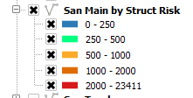
Notes:
And here’s the final city risk map, for the structural failure mode. It uses the same colour scheme as the criticality maps, but notice the scale is much smaller, where most mains have under 1000 dollars per year of risk. While the costs of a dig are high, the odds are small. But this map does things like call out how much more risk there is in VCT mains than concrete. That shows how much more justified it is to spend money on video and planned maintenance for VCT. It shows what it’s worth spending to do video inspections under major roads, or near ponds. It’s the main job of Asset Management, and now Calgary can automate that for the sanitary mains system.

Slide 38
Questions?
I’m retired.
Gloria’s here on break from Traffic.
Questions will be $1000 each.
In the bar.

